Slide 1









Slide 2






C is structured programming, it means that the C program is composed of small parts each part called “function”.
The first function to be executed (The entry point of the program) is called “main”.
Sometimes, we may write some functions in a stand alone file for organizing, this file is called “library”.
C Program
Library
Function_1
Functions
Call
main
Include
Call
Function_2

Slide 3





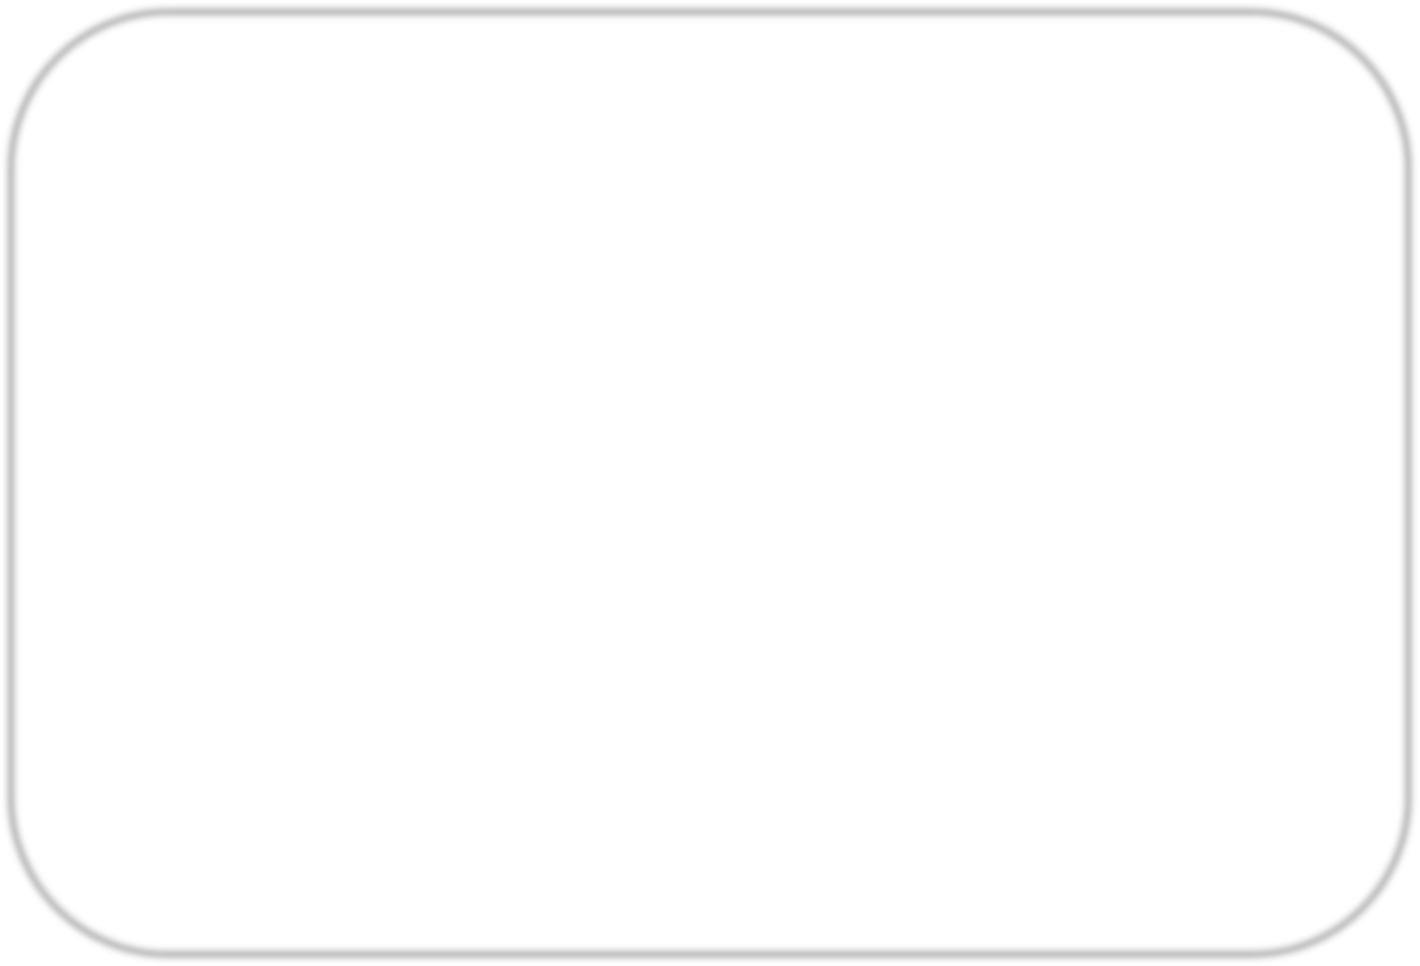
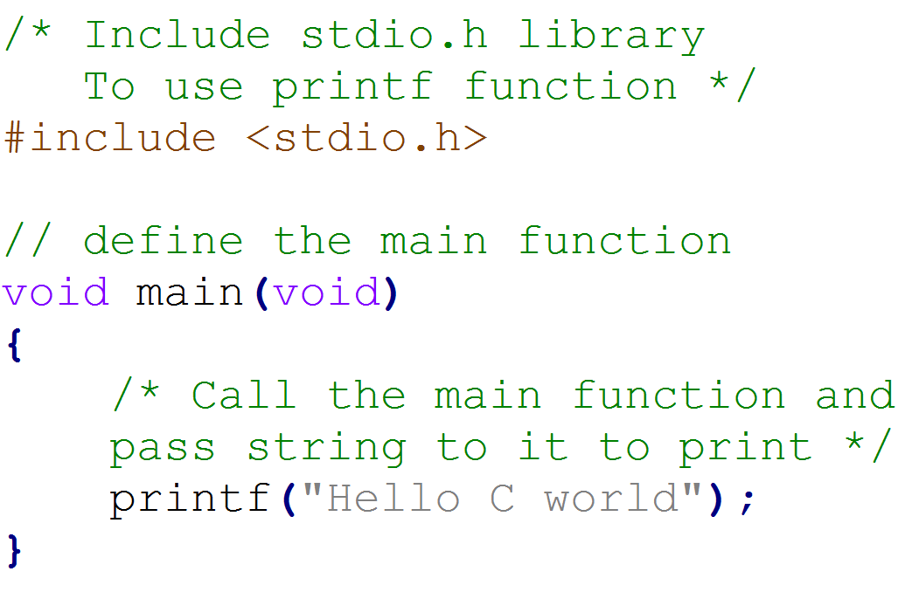



Multiline comment
Include command
Single line comment
printf function call
Any line inside a
function must ends
with semicolon ;

Slide 4




Comments are non-executable text used to provide documentation for the code. It provide clarity to the C source code allowing others to better understand what the code was intended to accomplish.
It is always recommended to use comments in your code, for that in IMT we have a rule, at least one comment for each code line.
1- Single-line comment
Any line preceded by two forward slashes //.
2- Multi-line comment
Any text starts with /* and ends with */

Slide 5



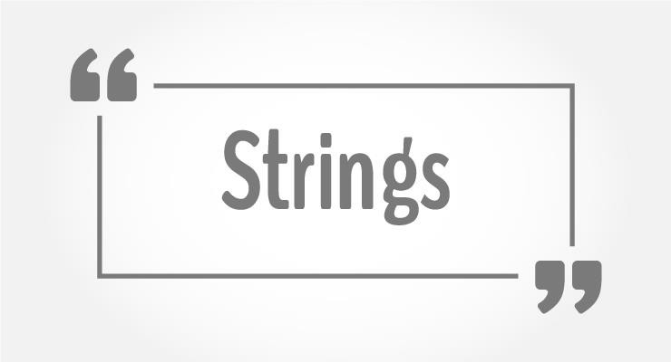
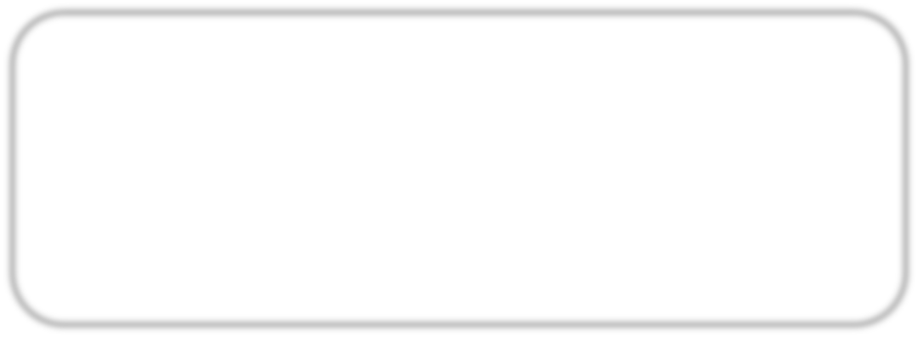
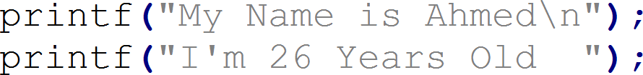
It is comprised of a set of characters that can also contain spaces, special characters and numbers.
In C string is represented between double quotation “ This is string “.
printf function will print the string passed
to it as it is.
Escape operator may be used inside the string \ , this operator may insert tab, new line or quotes.
\n | New line
\t | Horizontal tab
\v | Vertical tab
\’ | Single quote
\” | Double quote

Slide 6



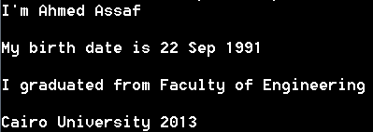




Expected Output
Write a C code that will print your short
biography.
Full Name, Birth Year, Faculty, and graduation year

Slide 7














Variable is a part from the memory, used to hold a piece of data.
The variable has a type, name and value.
The types of the variables differs in Size and/or Data to be saved.
Primitive Data Types
Decimal Types
Floating Types
Normally One Byte
Normally 4 Bytes
char
float
Normally 4 Bytes
int
double
Normally 8 Bytes
Note, Data types size may differ from one compiler to other, this issue will be discussed later.

Slide 8




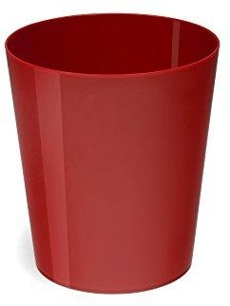
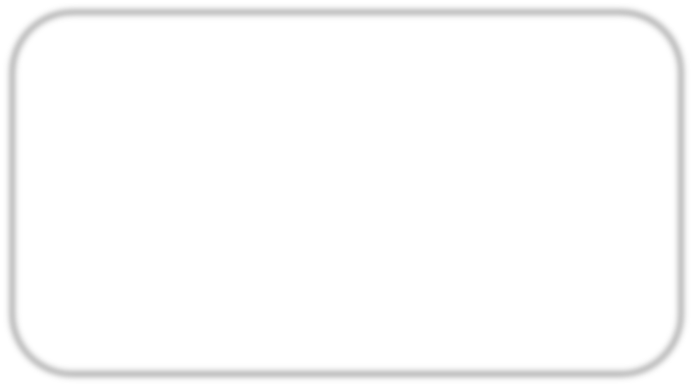
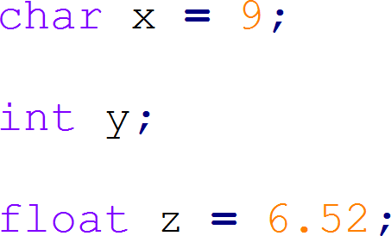

Data
Syntax
type name ;
Or
Variable
type
name
= initial_value ;
Define char variable and initialize it with 9
Define int variable with initialization, it will have a random value, called garbage
Define float variable and initialize it with floating number

Slide 9





Variable can contain:
Capital Letters A to Z
Small Letters a to z
Numbers 0 to 9
Underscore _
First Character must be alphabet or Underscore
Allowed
Not Allowed
Blanks & Commas are not allowed
No Special Symbols other than underscore are allowed, ex ?, #, ….. etc
Variable name Should not be Reserved Word
Variable name can not be repeated in the same scope “Will be clarified later”

Slide 10

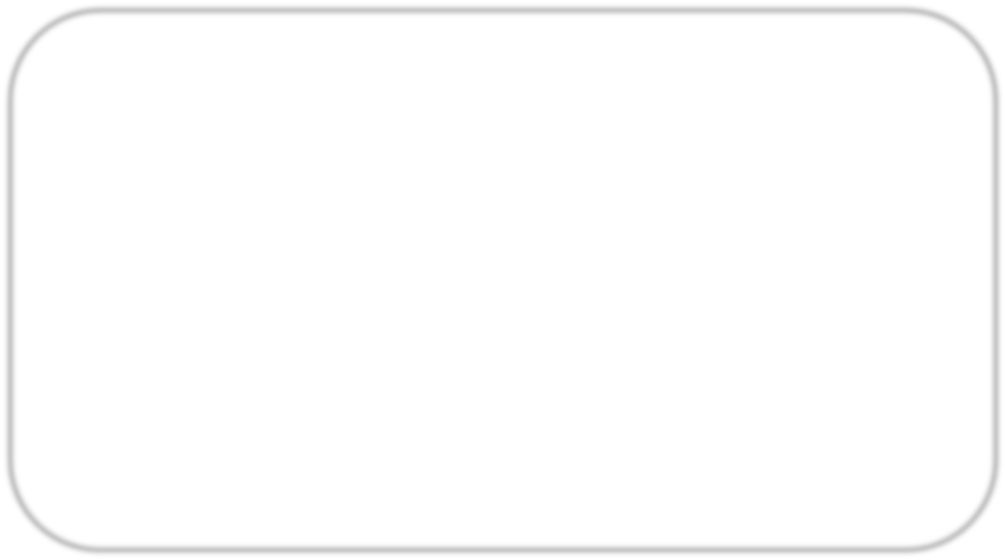

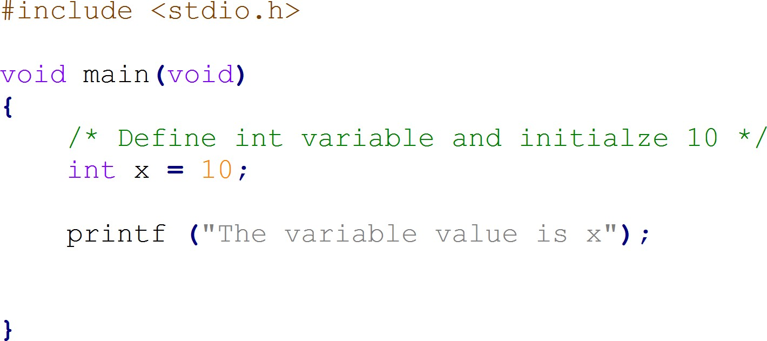
What will be the output of the following code … ?

Slide 11

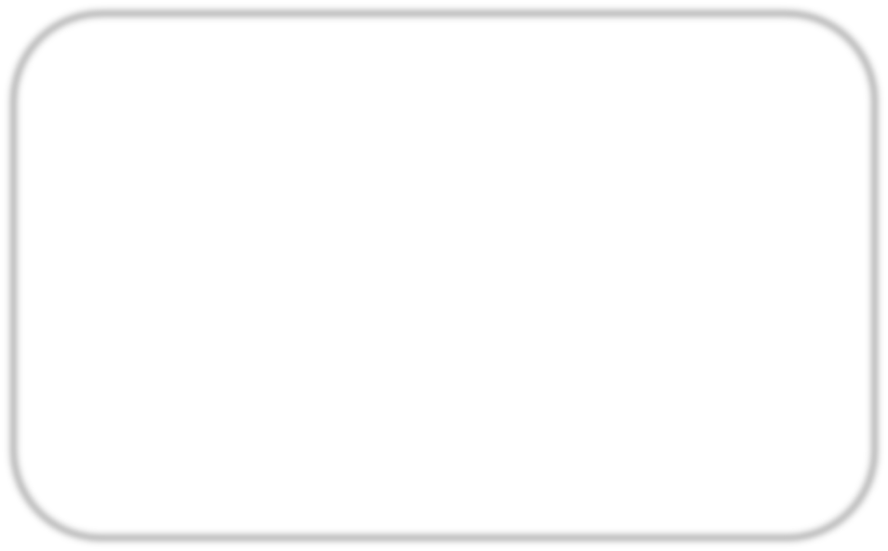
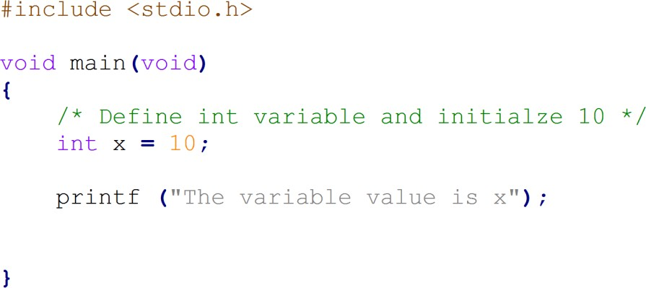

Output
The string will be printed as it is, it will not replace x with its value. Instead it will deal with x as a normal character not a variable.

Slide 12






printf function can print a variable inside the string, it could be done by inserting format specifier that will be replaced by the values specified in subsequent additional arguments.
Example
The output
This format specifier will be replaced by the value of x
%d | Format specifier for decimal value
%f | Format specifier for floating value
%c | Format specifier for character value
Common specifiers used
with printf function

Slide 13




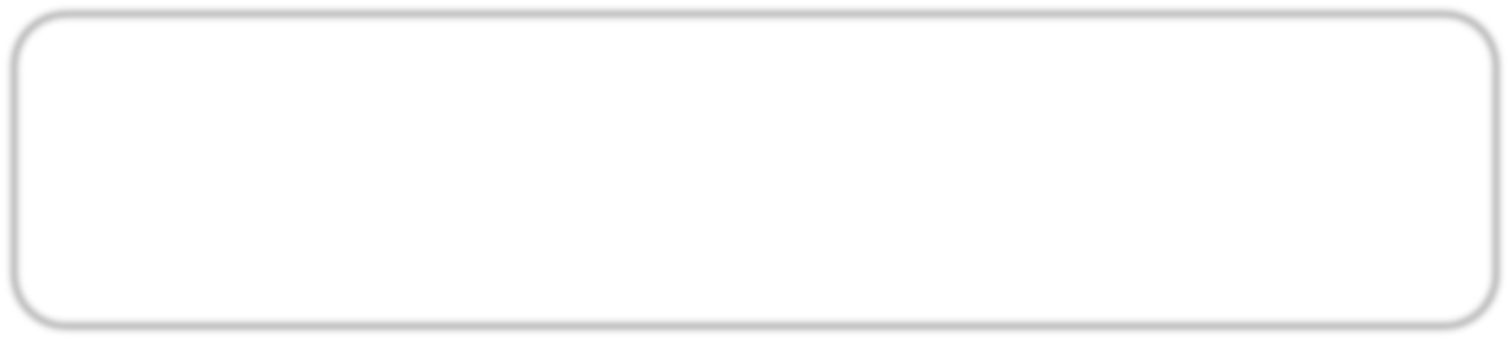
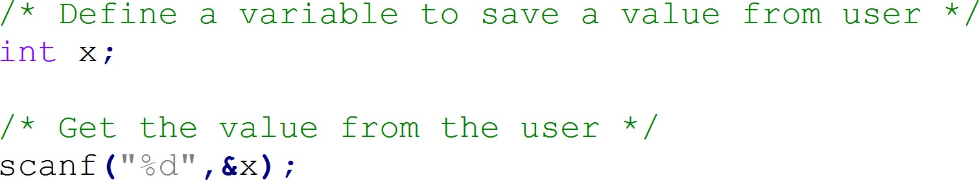
scanf function is a part from the stdio library, it is used to get value from the user and save it in a variable.
Syntax
This operator must be written
and will be discussed later
scanf( “formatSpecifier” , &VariableName );
Example

Slide 14




Expected Output
Write a C code that will ask the
user to enter a value then print it.

Slide 15




Arithmetic | Uni |  | ++ |  |  |  |  |  |  | --
 | Bi |  | + |  |  | - |  |  | * |  |  |  | / |  | %
Bit wise | & | | |  | ~ |  |  |  | ^ |  |  | >> |  |  | <<
Assignment | = | += | -= |  |  | *= |  |  | /= |  |  |  | %= |  | +=
 | &= | |= |  | ^= |  |  |  | >>= |  |  | <<=
Relational | > | < |  | >= |  |  |  | <= |  |  | == |  |  | !=
Logical | && |  |  |  | || |  |  |  |  |  |  | !
Other | Size of operator |  |  |  |  |  | sizeof()
 | Ternary operator |  |  |  |  |  | ? : ;
 | Address operator |  |  |  |  |  | & ( will be discussed later )
 | Dereference |  |  |  |  |  | * ( will be discussed later )
 | Subscriptor |  |  |  |  |  | [ ] ( will be discussed later )

Slide 16



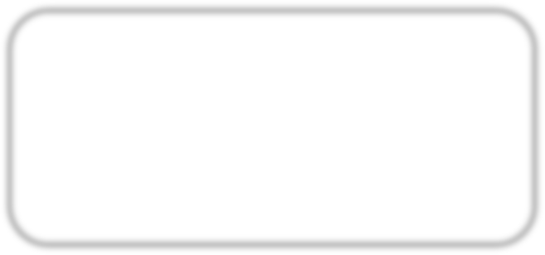
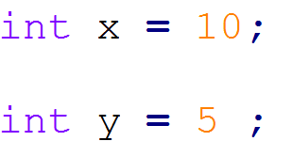
Bi Operators, operators that takes two operands
Summation
example
Subtraction
example
Multiplication
example
Division
example

Slide 17



Bi Operators, operators that takes two operands
5- Modulus ( reminder )
example
example example example
example

Slide 18



Expected Output
Write a C code that will ask the user to enter two values and print their summation and multiplication.

Slide 19
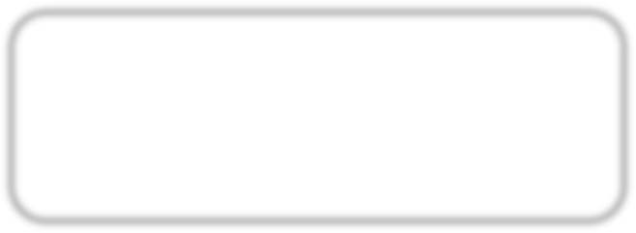



Uni Operators, operators that takes one operand
1- Increment
example
Postfix
example
Prefix
2- Decrement
example
Postfix
example
Prefix
Note: In previous examples, no difference between postfix and prefix cases

Slide 20
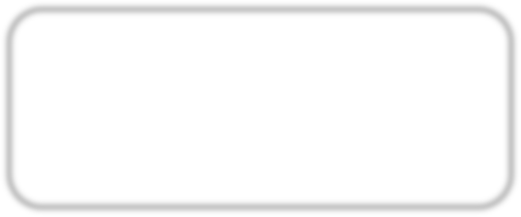
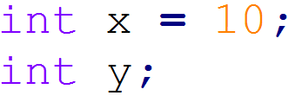
Uni Operators, operators that takes one operand
Increment
example
Assign x to y, then increment x
example
Increment x, then assign x to y
Decrement
example
Assign x to y, then decrement x
example
Decrement x, then assign x to y

Slide 21



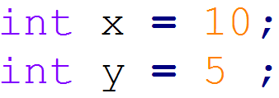
To apply these operators correctly, let’s first imagine these numbers in binary
x = 00001010
y = 00000101
And
example
Or
example
Not
example
XOR
example

Slide 22

To apply these operators correctly, let’s first imaging these numbers in binary
x = 1010
y = 0101
6- Right shift
example
Variable to shift
Shifting steps
7- Left shift
example

Slide 23




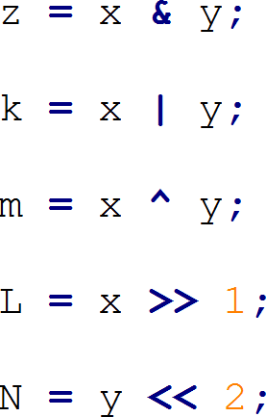



Solve these examples in a paper and confirm the that your
answers are correct by writing a code printing the result

Slide 24
Assignment operators
Assign
example:
Add and Assign
example:
Subtract and Assign
example:
Multiply and Assign
example:
Divide and Assign example:

Slide 25



6- Modulus and Assignment
example:
7- And then Assign
example:
8- Or then Assign
example:
9- XOR then Assign
example:

Slide 26



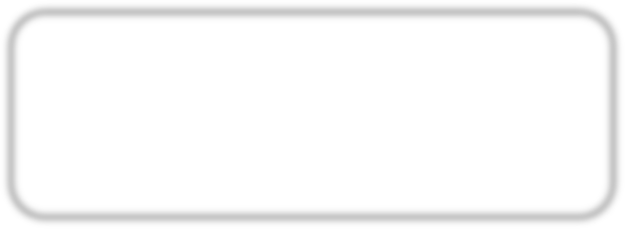
10- Shift right then Assign
example:
11- Shift left then Assign
example:

Slide 27




Any questions
… ?
Other types of operators will be discussed later on, …..

Slide 28

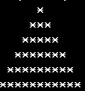
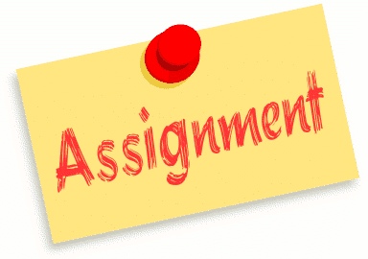
Write a code that can draw this pyramid

Slide 29



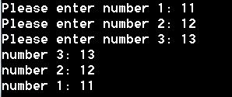
Write a code that scan 3 numbers from the user and print them in reversed order

Slide 30

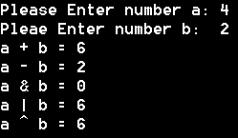
Write a code that takes 2 numbers and print their summation, subtraction, anding, oring, and Xoring

Slide 31
Thank you

